Slide 1
Unified Modelling Language

Slide 2
Object Modelling Using UML
UML is a modelling language.
  Not a system design or development methodology
Used to document object-oriented analysis and design results.
Independent of any specific design methodology.

Slide 3
UML Origin
OOD in late 1980s and early 1990s:
  Different software development houses were using different notations.
  Methodologies were tied to notations.
UML developed in early 1990s:
  To standardize the large number of object-oriented modelling notations that existed.

Slide 4
UML Lineology
Based Principally on:
  OMT [Rumbaugh 1991]
  Booch’s methodology[Booch 1991]
  OOSE [Jacobson 1992]
  Odell’s methodology[Odell 1992]
  Shlaer and Mellor [Shlaer 1992]

Slide 5
Different Object Modeling Techniques in UML
OMT
UML
Booch’s
Methodology
OOSE

Slide 6
UML as A Standard
Adopted by Object Management Group (OMG) in 1997.
OMG is an association of industries
Promotes consensus notations and techniques
UML also being used outside software development area:
  Example car manufacturing

Slide 7
History of UML
UML 2.0
Industrialization
UML 1.1
Standardization
public feedback
UML 0.9 & 0.91
UML 0.9 & 0.91
Unification
Unified method 0.8
Booch'93
OMT-2
Fragmentation
Other methods
Booch'91
OMT-1
OOSE

Slide 8
Developments to UML
UML 2.0
2003
UML continues to develop:
  Refinements
  Making it applicable to new contexts
Application to embedded systems
UML 1.X
UML 1.0
1997

Slide 9
Why are UML Models Required?
Modelling is an abstraction mechanism:
  Capture only important aspects and ignores the rest.
  Different models result when different aspects are ignored.
  An effective mechanism to handle complexity.
UML is a graphical modelling tool
Easy to understand and construct

Slide 10
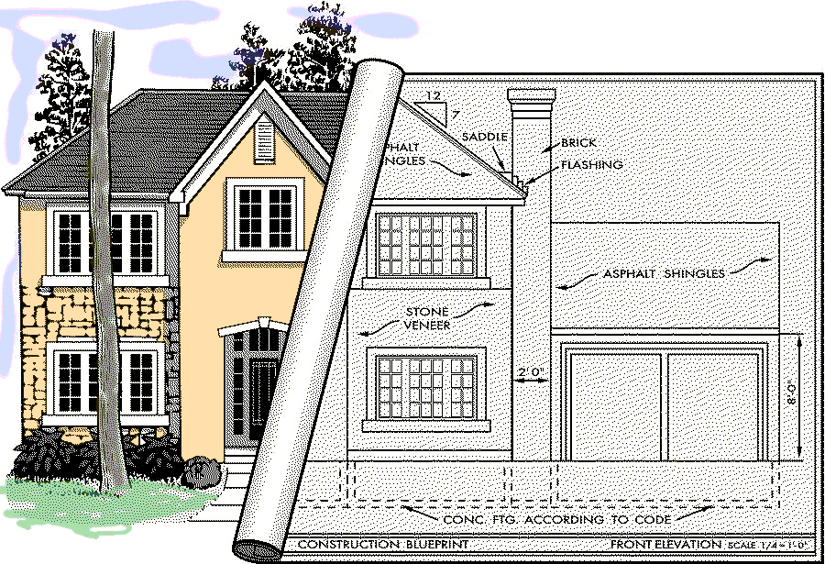
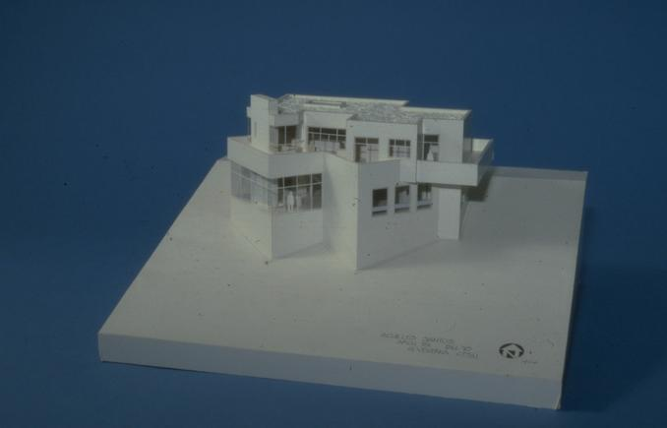
Modeling a House

Slide 11
UML Diagrams
Nine diagrams in UML1.x :
  Used to capture 5 different views of a system.
Views:
  Provide different perspectives of a software system.
Diagrams can be refined to get the actual implementation of a system.

Slide 12
UML Model Views
Views of a system:
  User’s view
  Structural view
  Behavioral view
  Implementation view
  Environmental view

Slide 13
Diagrams and views in UML
Behavioural View
Sequence Diagram
Collaboration Diagram
- State-chart Diagram
- Activity Diagram
Structural View
Class Diagram
Object Diagram
User’s View
Use Case
Diagram
Implementation View
Component Diagram
Environmental View
Deployment Diagram

Slide 14
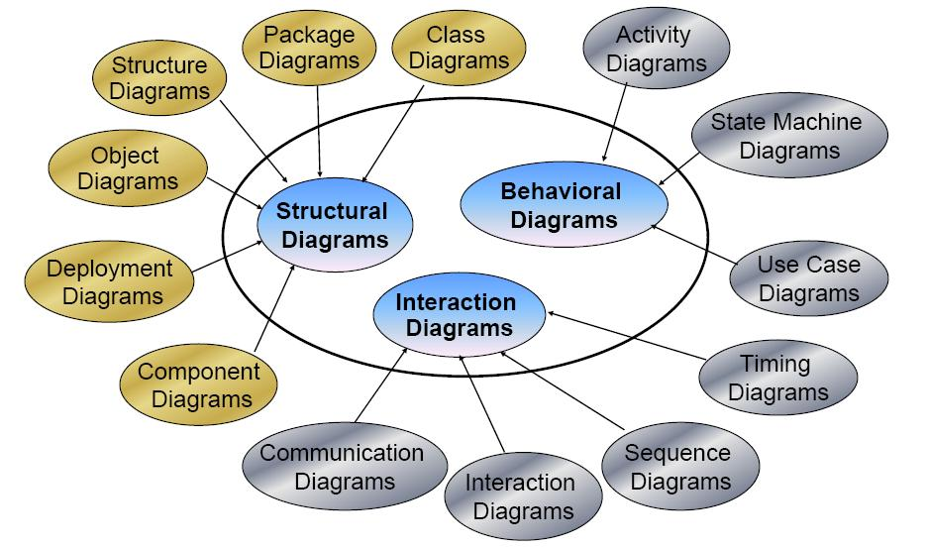
Diagrams in the UML 2.0 -- 13 Diagrams
Notes:
It is not necessary to discuss any of these diagrams in detail. The points to make are:
1. More than one diagram is necessary to represent software
2. The UML has made a tremendous contribution in giving us a common visual language to express these models.
All of these diagrams can be created using Rational Rose with the exception of the activity diagrams.

Slide 15
UML 2.0 Diagrams
Class
Diagram
Component
Diagram
Structure
Diagram
Composite
Structure Diagram
Deployment
Diagram
Object
Diagram
Package
Diagram
UML 2.0
Diagram
Sequence
Diagram
Use Case
Diagram
Behavior
Diagram
Communication
Diagram
Activity
Diagram
Interaction
Overview
Diagram
Interaction
Diagram
State Machine
Diagram
Timing
Diagram

Slide 16
Structural Diagrams
Class Diagram
  set of classes and their relationships.
Object Diagram
  set of objects (class instances) and their relationships
Component Diagram
  logical groupings of elements and their relationships
Deployment Diagram
  set of computational resources (nodes) that host each component.

Slide 17
Behavioral Diagrams
Use Case Diagram
  high-level behaviors of the system, user goals, external entities: actors
Sequence Diagram
  focus on time ordering of messages
Collaboration Diagram
  focus on structural organization of objects and messages
State Chart Diagram
  event driven state changes of system
Activity Diagram
  flow of control between activities

Slide 18
Quotable Quotes on Using UML
“UML is a large and growing beast, but you don’t need all of it in every problem you solve…” – Martin Fowler
“…when learning the UML, you need to be aware that certain constructs and notations are only helpful in detailed design while others are useful in requirements analysis …”
– Brian Henderson-Sellers

Slide 19
Are All Views Required for Developing A Typical System?
NO
For a simple system:
  Use case diagram, class diagram and one of the interaction diagrams only.
State chart diagram:
  when class has significant states.
  When states are only one or two, state chart model becomes trivial
Deployment diagram:
  In case several hardware components used to develop the system.

Slide 20
Key Diagrams in UML
Requirements
System Structure
System Behaviour
Use Case Diagrams
Class Diagrams
Collaboration Diagrams
Interaction Diagrams
Activity Diagrams
State Charts
Notes:
This part of the course will give you an introduction to key elements of the UMLnotation - it is not a blow by blow account of all the standard notation - the latter would be neither particularly helpful nor interesting! Like many standards there is much more in it than you will ever really want to know - but it is important to know that it exists.
The lectures we will cover do not tell you all there is to know about UML - all we are trying to do here is give you a way into the notation and gain some insight in what it has to offer.
The above slide summarises the parts of the UML that we will explore through the two sessions. There is also something called CRC cards that we will mention. The CRC cards are *not* part of the UML - but they are a useful technique to know about for reasons that we will discuss later. As a post-sessions exercise, if you search for CRC cards on the Internet you will see that they are a fairly common topic when developing and testing OO designs using the UML.

Slide 21
Use Case Modelling

Slide 22
Use Case Model
Consists of a set of “use cases”
It is the central model:
  Other models must conform to this model
  Not really an object-oriented model
  A functional model of the system

Slide 23
A Use Case
A way in which a system can be used by the users to achieve specific goals
Corresponds to a high-level requirement.
Defines external behavior without revealing internal structure of system
Set of related scenarios tied together by a common goal.

Slide 24
Use Cases Cont…
Normally, use cases are independent of each other
Implicit dependencies may exist
Example: In Library Automation System, renew-book and reserve-book are independent use cases.
  But in actual implementation of renew-book--- A check is made to see if any book has been reserved using reserve-book.

Slide 25
Example Use Cases
  Library information system
    issue-book
    query-book
    return-book
    create-member
    add-book, etc.

Slide 26
Representation of Use Cases
Represented in a use case diagram
A use case is represented by an ellipse
System boundary is represented by a rectangle
Users are represented by stick person icons (actor)‏
Communication relationship between actor and use case by a line
External system by a stereotype
  <<external stysem>>
Tic-tac-toe game
Play Move

Slide 27
What is a Connection?
A connection is an association between an actor and a use case.
Depicts a usage relationship
Connection does not indicate data flow
Tic-tac-toe game
Play Move

Slide 28
Use Case Modelling

Slide 29
Effective Use Case Modelling
Use cases should start off simple and at as much high view as possible.
  Can be refined and detailed further.
Use case diagrams represent functionality:
  Should focus on the "what" and not the "how".

Slide 30
An Example Use Case Diagram
Tic-tac-toe game
Play Move
Player
Use cases should be named and organized from the perspective of the actor.
Use case model

Slide 31
Relationships between Use Cases and Actors
Actors may be connected to a use case by association relation:
  Indicating that the actor and the use case communicate with one another.
update
grades
faculty

Slide 32

Another Example Use Case Diagram
Video Store Information System
Rent Videos
Clerk
<<external system>>
Credit Authorization Service
. . .

Slide 33
Exercise1: Video Store Information System
Video Store Information System supports the following business functions:
  Recording information about videos the store owns
    This database is searchable by staff and all customers
  Information about a customer’s borrowed videos
    Access by staff and also the customer. It involves video database searching.
  Staff can record video rentals and returns by customers. It involves video database searching.
  Staff can maintain customer, video and staff information.
  Managers of the store can generate various reports.

Slide 34
Exercise 1: Solution
Video Store Information System
Rent/Return
Videos
Staff
«include»
Customer
Search for
Videos
Maintain
Customers
«include»
Maintain
Videos
Manager
Generate
Reports

Slide 35
Yet Another Use Case Example
Telephone Catalog
Check Status
Salesperson
Place Order
Fill Orders
Shipping Clerk
Customer
Establish credit
Supervisor

Slide 36
Text Description
Mainline Sequence(Basic course):
  Scenario 1: Mainline sequence
Alternate scenarios(courses):
  Scenario 2: At step 4 of mainline sequence
  …..

Slide 37
Text Description
Contact persons: This section lists of personnel of the client organisation with whom the use case was discussed, date and time of the meeting, etc.
Actors: In addition to identifying the actors, some information about actors using a use case which may help the implementation of the use case may be recorded.

Slide 38
Text Description
Pre-condition: The preconditions would describe the state of the system before the use case execution starts.
Post-condition: This captures the state of the system after the use case has successfully completed.

Slide 39
Text Description
Non-functional requirements : This could contain the important constraints for the design and implementation, such as platform and environment conditions, qualitative statements, response time requirements, etc.
Exceptions, error situations: This contains only the domain-related errors such as lack of user’s access rights, invalid entry in the input fields, etc.

Slide 40
Text Description
Sample dialogs: These serve as examples illustrating the use case.
Specific user interface requirements : These contain specific requirements for the user interface of the use case. For example, it may contain forms to be used, screen shots, interaction style, etc.
Document references: This part contains references to specific domain related documents which may be useful to understand the system operation.

Slide 41
Example: Use Case Model
Super market prize scheme
Register-customer
Customer
Register-sales
Select-winners
Sales Clerk
Clerk
Manager

Slide 42
Use Case Description: Super Market
U1: register-customer: Using this use case, the customer can register himself by providing the necessary details.
Scenario 1: Mainline sequence
  1. Customer: select register customer option
  2. System: display prompt to enter name, address, and telephone number.
  3. Customer: enter the necessary values
  4: System: display the generated id and the message that the customer has successfully been registered.

Slide 43
Use Case Description: Super Market
Scenario 2: At step 4 of mainline sequence
  4 : System: displays the message that the customer has already registered.
Scenario 3: At step 4 of mainline sequence
  4: System: displays message that some input information have not been entered. The system displays a prompt to enter the missing values.

Slide 44
Use Case Description: Super Market
U2: register-sales: Using this use case, the clerk can register the details of the purchase made by a customer.
Scenario 1: Mainline sequence
  1. Clerk: selects the register sales option.
  2. System: displays prompt to enter the purchase details
  and the id of the customer.
  3. Clerk: enters the required details.
  4. System: displays a message of having successfully
  registered the sale.
U3: select-winners. Using this use case, the manager can generate the winner list.
Scenario 1: Mainline sequence
  1. Manager: selects the select-winner option.
  2. System: displays the gold coin and the surprise gift
  winner list.

Slide 45
Use Case Description: Change Flight
Actors: traveler
Preconditions:
  Traveler has logged on to the system and selected ‘change flight itinerary’ option
Basic course
  System retrieves traveler’s account and flight itinerary from client account database
  System asks traveler to select itinerary segment she wants to change; traveler selects itinerary segment.
  System asks traveler for new departure and destination information; traveler provides information.
  If flights are available then
  …
  System displays transaction summary.
Alternative courses
  If no flights are available then …

Slide 46
Example: ATM Money Withdraw
Actors: Customer
Pre Condition:
  ATM must be in a state ready to accept transactions
  ATM must have at least some cash it can dispense
  ATM must have enough paper to print a receipt
Post Condition:
  The current amount of cash in the user account is the amount before withdraw minus withdraw amount
  A receipt was printed on the withdraw amount

Slide 47
ATM Money Withdraw Mainline Scenario
Actor Actions | System Actions
1. Begins when a Customer arrives at ATM
2. Customer inserts a Credit card into ATM | 3. System verifies the customer ID and status
5. Customer chooses “Withdraw” operation | 4. System asks for an operation type
7. Customer enters the cash amount | 6. System asks for the withdraw amount
 | 8. System checks if withdraw amount is legal
 | 9. System dispenses the cash
 | 10. System deduces the withdraw amount from account
 | 11. System prints a receipt
13. Customer takes the cash and the receipt | 12. System ejects the cash card

Slide 48
ATM Money Withdraw (cont.)
Alternative flow of events:
  Step 3: Customer authorization failed. Display an error message, cancel the transaction and eject the card.
  Step 8: Customer has insufficient funds in its account. Display an error message, and go to step 6.
  Step 8: Customer exceeds its legal amount. Display an error message, and go to step 6.
Exceptional flow of events:
  Power failure in the process of the transaction before step 9, cancel the transaction and eject the card.

Slide 49
Why Develop A Use Case Diagram?
Serves as type of requirements specification
How are actor identification useful in software development?
  Identifies different categories of users:
    Helps in implementing appropriate interfaces for each category of users.
    Security mechanism – login system
    Helps in preparing appropriate documents (e.g. user’s manual).

Slide 50
Guidelines for Effective Use Case Writing
Use simple sentence
Do not have both system and actor doing something in a single step
  Bad: “Get the amount from the user and give him the receipt.”
Any step should lead to some progress:
  Bad: “User clicks a key”
System
Actor
Actor asks for money
System asks for amount
Actor gives the amount
System produce the money

Slide 51
Identification of Use Cases
1. Actor-based:
  - Identify the actors related to a system or organization.
  For each actor, identify the processes they initiate or participate in.
Ex: LSM
  Member: Book issue, return and renewal
  Librarian: Creation/ Deletion of member/book records
  Accountant: Membership fees, fine, expenses

Slide 52
Factoring Use Cases
Two main reasons for factoring:
  Complex use cases need to be factored into simpler use cases
  To represent common behavior across different use cases
Three ways of factoring:
  Generalization
  Include
  Extend

Slide 53
Generalization
One use case that is similar to another, but does something slightly differently or something more.
The child use case inherits the
behavior of the parent use case.
  The child may add to or override some of the behavior of its parent.
parent
child

Slide 54
Generalization Example 1
Registration
Under-graduate
registration
Graduate
registration

Slide 55
Factoring Use Cases Using
Generalization
Pay membership fee
Pay through credit card
Pay through library pay card

Slide 56
Include
When you have a piece of behavior that is similar across many use cases
  Break this out as a separate use-case and let the other ones “include” it
Examples of use case include
  Validate user interaction
  Check for proper authorization

Slide 57
Factoring Use Cases using Include
Base use case
Common
use case
<<include>>
Base use case 2
Base use case 1
<<include>>
<<include>>
<<include>>
<<include>>
Common use case 1
Common use case 2
Common use case 3

Slide 58
Dependency in Use Cases
Normally, use cases are independent of each other
Implicit dependencies may exist
Example: In Library Automation System, issue-book/renew-book and reserve-book are independent use cases.
  But in actual implementation of renew-book--- A check is made to see if any book has been reserved using reserve-book.

Slide 59
Example of Factoring Use Cases Using Includes
Issue Book
Renew Book
<<include>>
<<include>>
Check Reservation

Slide 60
Video Store Information System
Video Store Information System supports the following business functions:
  Recording information about videos the store owns
    This database is searchable by staff and all customers
  Information about a customer’s borrowed videos
    Access by staff and also the customer. It involves video database searching.
  Staff can record video rentals and returns by customers. It involves video database searching.
  Staff can maintain customer, video and staff information.
  Managers of the store can generate various reports.

Slide 61
Example
Video Store Information System
Rent/Return
Videos
Staff
«include»
Customer
Search for
Videos
Maintain
Customers
«include»
Maintain
Videos
Manager
Generate
Reports

Slide 62
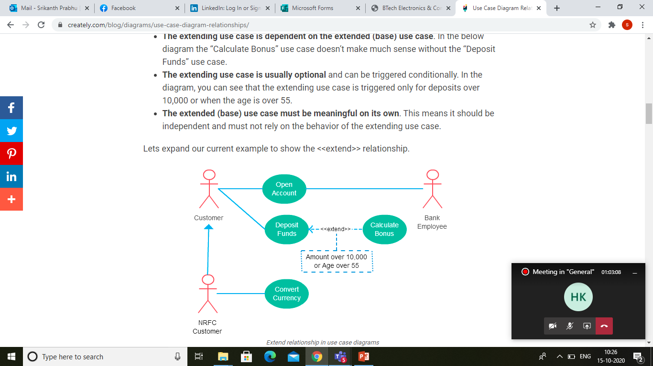

Slide 63
Extends
Use when a use-case optionally can do a little bit more:
  Capture the normal behavior
  Capture the extra behavior in a separate use-case (condition execution)
  Create extends dependency
Makes it a lot easier to understand

Slide 64
Factoring Use Cases Using
Extends
Base
use case
Common
use case
<<extends>>

Slide 65
Factoring Use Cases Using
Extends
Order
Item
Show
Catalog
<<extends>>

Slide 66
Extension Point
The base use case may include/extends other use cases:
  At certain points, called extension points.
Note the direction of the arrow
<<extend>>
Product is a gift
Perform Sale
After checkout
Gift wrap Product

Slide 67
Use Case Relationships
Order Product
Supply Customer Data
Arrange Payment
<<include>>
<<include>>
<<include>>
Place Order
Cash Payment
Credit Payment
Sales Person
<<extends>>
Salesperson asks for catalog
Request Catalog

Slide 68
Example: Use Case Model for Course Management Software
At the beginning of each semester,
  Each professor shall register the courses that he is going to teach.
A student can select up to four-course offerings.
  During registration a students can request a course catalogue showing course offerings for the semester.
  Information about each course such as professor, department and prerequisites would be displayed.
  The registration system sends information to the billing system so the students can be billed for the semester.
For each semester, there is a period of time during which dropping of courses is permitted.
Professors must be able to access the system to see which students signed up for each of their course offerings.

Slide 69
Exercise 2: Answer
Course Management Software
Register offering
See Course List
Show registration
Professor
<<Extends>>
{ reg courses< 5 courses}
Register course
<<External>>
Billing System
Student
{ if today<set date }
Drop Course
Calendar

Slide 70
Factoring: Organization of Use cases
use case 1
External users
use case 1
use case 3
use case 2
Hierarchical
Organization of
Use Cases
use case 3.1
use case 3.3
Subsystems
use case 3. 2
use case 1
use case 3
use case 1
Methods
use case 2

Slide 71
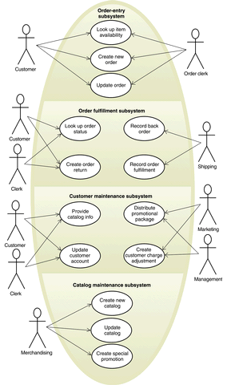
Too many use cases at any level should be avoided!

Slide 72
Use Case Packaging
Accounts
Query balance
Print
Balance sheet
Receive
grant
Make
payments
Package the related uses cases so that at best
6-7 packages present at the top level diagram

Slide 73
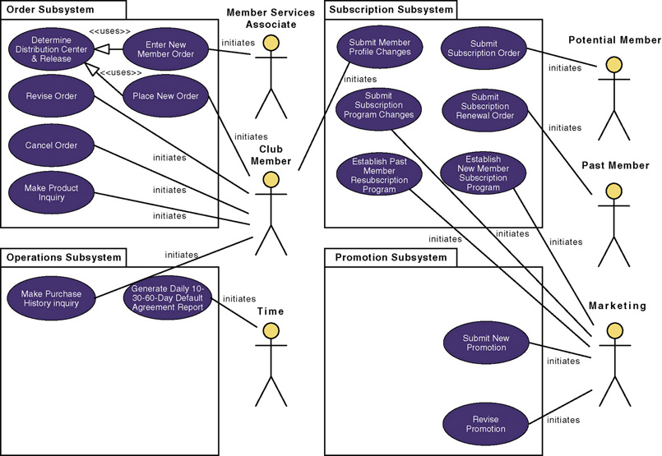
Use-Case Model using Packaging

Slide 74
Exercise: Home Assignment System - Use Case Model
HAS will be used by the instructor to:
  Distribute the homework assignments,
  Review the students’ solutions,
  Distribute suggested solution,
  Assign grade to each assignment.
Students can:
  Download assignments
  Submit assignment solutions
System:
  Automatically reminds the students a day before an assignment is due.

Slide 75
Quiz: Solution 1 (Inferior)
Remind Student
Calendar
Distribute Assignments
Get Assignment
Post Solutions
Submit Assignment
<<Extends>>
Student
Distribute Grade
Get Solution
Instructor
Get Grade

Slide 76
Quiz: Alternate (Better) Solution
Distribute Assignments
Post Solutions
Student
Distribute Grade
Instructor
Submit Assignment
Remind Student
Calendar

Slide 77
Class Diagrams

Slide 78
Class Diagram: Already Discussed!!
Describes static structure of a system
Main constituents are classes and their relationships:
  Generalization
  Aggregation
  Association
  Various kinds of dependencies

Slide 79
Class Diagram
Classes:
  Entities with common features, i.e. attributes and operations.
  Represented as solid outline rectangle with compartments.
  Compartments for name, attributes, and operations.
  Attribute and operation compartments are optional depending on the purpose of a diagram.

Slide 80
UML Class Representation
LibraryMember
LibraryMember
LibraryMember
Member Name
Membership Number
Address
Phone Number
E-Mail Address
Membership Admission Date
Membership Expiry Date
Books Issued
issueBook( );
findPendingBooks( );
findOverdueBooks( );
returnBook( );
findMembershipDetails( );
issueBook( );
findPendingBooks( );
findOverdueBooks( );
returnBook( );
findMembershipDetails( );
Different representations of the LibraryMember class

Slide 81
Class Diagram
Attributes:
  Multiplicity expression, type, initialization
  e.g., sensorStatusid[10]: Int = 0
Operation
  Abstract operations are written in italics
  Parameter kind: in / out / inout
  Return type(….():type)

Slide 82
Visibility of Attributes and Operations
Visibility
Symbol
Accessible To
Public
+
All objects within your system.
Protected
#
Instances of the implementing class and its subclasses.
Private
-
Instances of the implementing class.
Notes:
Operations in a Class
Also can be shown on attributes
Put in front of the name of the attribute or operation on the class diagram
Visibility of the attribute/operation in the system
Public – not hidden from any object
Protected – hidden from all other classes except its immediate subclasses
Private – default; hidden from all other classes

Slide 83

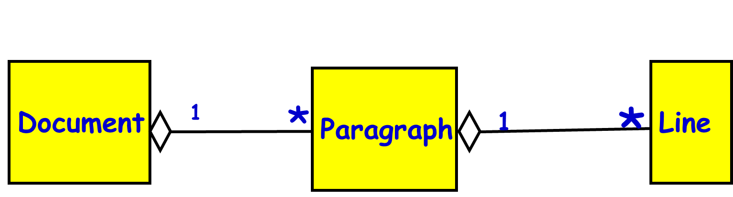
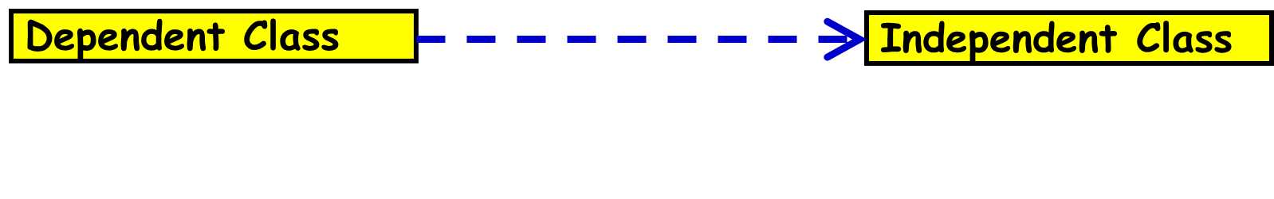
Summary of Relationships Between Classes
Association
  Permanent, structural, “has a”
  Solid line (arrowhead optional)
Aggregation
  Permanent, structural, a whole created from parts
  Solid line with diamond from whole
Dependency
  Temporary, “uses a”
  Dotted line with arrowhead
Generalization
  Inheritance, “is a”
  Solid line with open (triangular) arrowhead
Constraints
  Annotate class with {…..}
OR

Slide 84
Multiplicity
Denotes the minimum number.. maximum number of instances
  Exactly one 1
  Zero or more 0..* or 0..m
  One or more 1..* or 1..m
  Zero or one 0..1
  Specified range 2..4
  Multiple, disjoint ranges 1..3, 5
Notes:
Relationships in a class diagram
Used because you may want to restrict the number of instances a class may have
Zero/one or more use m or some other variable name when there is a specific number in the problem
Specified range 2 to 4 instances
Multiple, disjoint ranges 1..3, 5 == 1 to 3 or 5 instances

Slide 85
Inheritance Example
Library
Book
issuable
reference
Issuable
Single Volume
Book
Issuable
BookSet
Reference
Single Volume
Book
Reference
BookSet
Discriminator: allows one to group subclasses into
clusters that correspond to a semantic category.

Slide 86
Object(Instance) Diagram
(LibraryMember)
Mritunjay
B10028
C-108, Laksmikant Hall
1119
Mrituj@cse
25-02-04
25-03-06
NIL
issueBook( );
findPendingBooks( );
findOverdueBooks( );
returnBook( );
findMembershipDetails( );
(LibraryMember)
Mritunjay
B10028
C-108, Laksmikant Hall
1119
Mrituj@cse
25-02-04
25-03-06
NIL
(LibraryMember)
Different representations of the LibraryMember object

Slide 87
Example 1: University Courses
Some instructors are professors, while others have job title adjunct
Departments offer many courses, but a course may be offered by >1 department
Courses are taught by instructors, who may teach up to three courses
Instructors are assigned to one (or more) departments
One instructor also serves a department chair
G-<number>
2/14/05

Slide 88
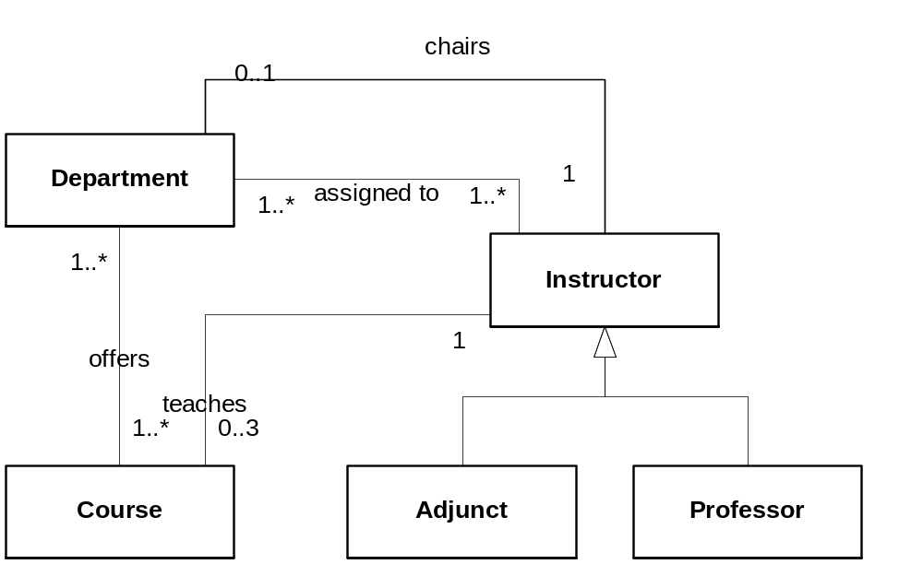
Class Diagram for Univ. Courses
G-<number>
2/14/05

Slide 89
Example
0..1
has
0..1
School
Department
1
1
1..n
1..n
1..n
1..n
1..n
1..n
assignedTo
member
-chairperson
n
1..n
n
1..n
0..1
Student
attends
Course
teaches
Instructor
n
n
1..n
n
n
1..n

Slide 90
Deriving Class Diagram from
Use Cases and Scenarios
Analyze the text in the use-case descriptions and scenarios
Notes:
Class diagram
Examine the text to identify potential objects, attributes, operations, and relationships

Slide 91
Guidelines for Analyzing Use Cases
A common or improper noun implies a class e.g. Book
A proper noun implies an object (instance of a class): CSE Dept, OOSD, etsc.
An adjective implies an attribute e.g. price of book
A “doing” verb implies an operation
  Can also imply a relationship e.g. student issues Book
A “having” verb implies an aggregation relationship
A predicate or descriptive verb phrase elaborates an operation e.g. ISBN numbers are integers
An adverb implies an attribute of an operation e.g. fast loading of image…

Slide 92
Guidelines for Analyzing Use Cases
A common or improper noun implies a class of objects
A proper noun implies an instance of a class
A collective noun implies a class of objects made up of groups of instances of another class
Notes:
Class diagram
Examine the text to identify potential objects, attributes, operations, and relationships

Slide 93
Guidelines for Analyzing Use Cases (2)
An adjective implies an attribute of an object
A doing verb implies an operation
A being verb implies a relationship between an object and its class
A having verb implies an aggregation or association relationship
Notes:
Class diagram
Examine the text to identify potential objects, attributes, operations, and relationships

Slide 94
Guidelines for Analyzing Use Cases (3)
A transitive verb implies an operation
An intransitive verb implies an exception
A predicate or descriptive verb phrase implies an operation
An adverb implies an attribute of a relationship or an operation
Notes:
Transitive Verb
The meaning of a transitive verb is incomplete without a direct object, as in the following examples:
INCOMPLETE COMPLETE
The shelf holds. The shelf holds three
books and a vase of
flowers.
The committee named. The committee named a
new chairperson.
The child broke. The child broke the plate.
Intransitive Verb
An intransitive verb, on the other hand, cannot take a direct object.
Example: This plant has thrived on the south windowsill.
Predicate
part of the sentence that contains a verb or verb phrase and its complements

Slide 95
Exercise: Problem Report Tool
A CASE tool for storing and tracking problem reports
  Each report contains a problem description and a status
  Each problem can be assigned to someone
  Problem reports are made on one of the “artifacts” of a project
  Employees are assigned to a project
  A manager may add new artifacts and assign problem reports to team members
G-<number>
2/14/05

Slide 96
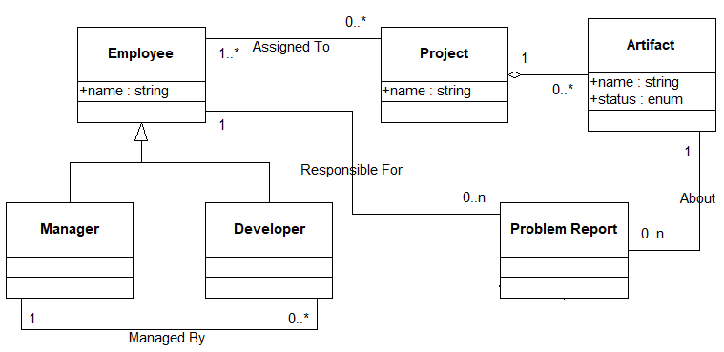
Class Diagram for Prob. Rep. Tool
G-<number>
2/14/05

Slide 97
Exercise
Develop UML Class diagram for a software that we have been assigned to develop to manage a library.
Each member has a name, date of birth, address, phone number and email
Each journal has a name, the ISBN code, the subject areas, the shelf where it is located and the editor. Each editor has a name and a nationality.
A journal may cover issues in several subject areas. It is important to store the order of appearance of areas, since these indicate their relative importance for the journal.
It is important to keep track of the date on which each journal has been borrowed, returned, disappeared, and the user carrying out the operation.

Slide 98
AreaOrder
-orderOfApperarance
1..*
1..*
Editor
Journal
Area
publishes
Addressed in
-editorName
-nationality
-journalName
ISBN
-shelf
-areaName
areaDetails
1
0..*
1
has
0..*
Member
Operation
0..*
1
-userName
-address
-birthDate
-phone
-email
-date
-operationType
performs

Slide 99

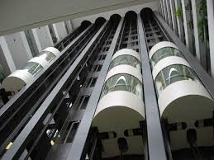
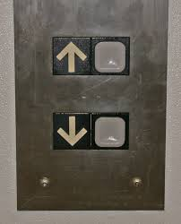

Elevator System

Slide 100
Identify Classes and Relations
Controller program for an elevator is to be developed.
Each elevator has a set of m buttons, one for each floor.
  These illuminate when pressed and cause the elevator to visit the corresponding floor.
  The illumination is canceled when the elevator reaches the corresponding floor.
Each floor, except the first floor and top floor has two buttons:
  One to request and up-elevator and one to request a down-elevator.
  These buttons illuminate when pressed. The illumination is canceled when an elevator visits the floor. The door opens as soon as it stops at a floor.
When an elevator has no requests, it remains at its current floor with its doors closed.

Slide 101
Elevator
Elevator_Controller
control
Door
control
1
*
Button
Elevator_Button
Floor_Button

Slide 102
Class Diagram: Problem
  Draw a class diagram using the UML syntax to represent the fact that an orderRegister consists of many orders. Each order consists of up to ten order items. Each order item contains the name of the item, its quantity and the date by which it is required. Each order item is described by an item order specification object having details of an order item such as its unit price, name and address of the manufacturer , and the warranty period and terms of warranty.

Slide 103
Class Diagram: Problem
  Draw a class diagram using the UML syntax to represent the following aspects concerning a library. An issuable can either be a book or a CD. Books can be either reference books or text books. The details of various issuables are maintained in a register called the issuable register. The library has many members whose details are maintained in a member register . A member can issue upto 10 text books for a month. A member can also issue two CDs for a week.

Slide 104
Class Diagram: Problem
  Draw a class diagram using the UML syntax to represent the fact that the fleet of vehicles at a travel agency consists of vehicles of the types Tata Indica, Maruti van, and Mahindra Xylo. The regular customers of the travel agency can rent any vehicle they want. The details of the customers such as the name, address, and phone number are maintained by the agency

Slide 105
Class Diagram: Problem
  Draw a class diagram using the UML syntax to represent the following. An engineering college offers B.Tech degrees in three branches— Electronics, Electrical, and Computer science and engineering. Each branch can admit 30 students each year . For a student to complete, B.Tech degree he/she has to clear all the 30 core courses and at least 10 of the elective courses.

Slide 106
Interaction Diagrams

Slide 107
Interaction Diagram
Can model the way a group of objects collaborate to realize some behaviour.
How many interaction diagrams to draw?
  Typically each interaction diagram realizes behaviour of a single use case
  Draw one sequence diagram for each use case.

Slide 108
Interaction Diagrams
Kinds:
  Sequence and Collaboration diagrams.
Sequence and Collaboration diagrams are equivalent:
  Portray different perspectives
  These diagrams play a very important role in the design process.

Slide 109
A First Look at Sequence Diagrams
Captures how objects interact with each other:
  To realize some behavior.
Emphasizes time ordering of messages.
Can model:
  Simple sequential flow, branching, iteration, recursion, and concurrency.

Slide 110
Sequence Diagram
Shows interaction among objects as a two-dimensional chart
Objects are shown as boxes at top
If object created during execution:
  Then shown at appropriate place in time line
Object existence is shown as dashed lines (lifeline)‏
Object activeness, shown as a rectangle on lifeline

Slide 111
Sequence Diagram Cont…
Messages are shown as arrows.
Each message labelled with corresponding message name.
Each message can be labelled with some control information.
Two types of control information:
  condition ([])‏
  iteration (*)‏

Slide 112
Sequence Diagram Cont…
an Order Line
An object in a sequence diagram is rendered
as a box with a dashed line descending from it.
The line is called the object lifeline, and it
represents the existence of an object over a
period of time.

Slide 113
Sequence Diagram Cont…
an Order Line
a Stock Item
Messages are rendered as horizontal
arrows being passed from object to
object as time advances down the
object lifelines.
Conditions ( such as
[check = “true”] ) indicate when a
message gets passed.
check()
[check = “true”]
remove()

Slide 114
Sequence Diagram Cont…
an Order Line
a Stock Item
check()
Notice that the bottom arrow is different. The arrow head is not solid, and there is no accompanying message.
This arrow indicates a return from a previous message, not a new message.
[check = “true”]
remove()

Slide 115
Sequence Diagram Cont…
an Order
a Order Line
* prepare()
An iteration marker, such as * (as shown), or *[i = 1..n] , indicates that a message will be repeated as indicated.
marker

Slide 116
Sequence Diagram Cont…
an Order Entry
window
an Order
an Order Line
a Stock Item
prepare()
Condition
* prepare()
Object
check()
Message
[check = “true”]
remove()
needsToReorder()
Iteration
Return
Self-Delegation
new
A Reorder
Item
A Delivery
Item
Creation

Slide 117
Gist of Syntax
iteration marker *[for all objects]
[condition]
  the message is sent only if the condition is true
self-delegation
  a message that an object sends to itself

Slide 118
Control logic in Interaction Diagrams
Conditional Message
  [ variable = value ] message()
  Message is sent only if clause evaluates to true
Iteration (Looping)
  * [ i := 1..N ] message()
  “*” is required; [ ... ] clause is optional
  The message is sent many times to possibly multiple receiver objects.

Slide 119
Elements of A Sequence Diagram
X-Axis (objects)
member:
LibraryMember
book:Book
:Book
Copy
borrow(book)
Object
Life Line
ok = canBorrow()
Y-Axis (time)
message
Activation box
[ok] borrow(member)
setTaken(member)
condition

Slide 120
Message Arrows for Communication
Message arrows represent communications between two objects in a sequence diagram
  Synchronous message :
    Sending object suspends action and waits for the response to the message
  Asynchronous message:
    Sending object continues with its operations without waiting for the response
  A return of control from the synchronous message
  A creation of a new entity
(filled head)
(open head)

Slide 121
An Example of A Sequence Diagram
:Library
Boundary
:Library
Book
Renewal
Controller
:Library
Book
Register
:Book
:Library
Member
renewBook
find MemberBorrowing
displayBorrowing
selectBooks
bookSelected
* find
[reserved]
[reserved]
apology
update
apology
confirm
confirm
updateMemberBorrowing
Sequence Diagram for the renew book use case

Slide 122
Exercise: Draw a sequence diagram to represent the following interactions between a video store clerk and objects in a video rental system. The scenario name is rent video:
  Clerk creates new a Rental object named aRental.The message includes arguments for memberID and videoID.
  aRental sends add MemberToRental message to Member object based on memberID, named aMember, which returns member details.
  aRental sends rentVideo message to a Video object based on the videoID, named aVideo, which returns video details.
  aRental returns all rental details to the actor.

Slide 123
Video Clerk
aMember
aVideo
aRental
create(memberID,videoID)
addMembertoRental()
Member details
rentVideo()
Video details
Rentaldetails

Slide 124
Exercise: Change Flight Itinerary
Actors: traveler, client account db, airline reservation system
Basic course:
  Traveler selects ‘change flight itinerary’ option
  System retrieves traveler’s account and flight itinerary from client account database
  System asks traveler to select itinerary segment she wants to change; traveler selects itinerary segment.
  System asks traveler for new departure and destination information; traveler provides information.
  If flights are available then …
  …
  System displays transaction summary.
Alternative course:
  If no flights are available then…

Slide 125
Example Answer: Change Flight Itinerary
Traveler
: Booking System
Client Account DBMS
Client Account DBMS
Airline Reservation System
change flight itinerary
get customer account
get itinerary
present itinerary
select segment
present detailed info
update information
available flight
:
:

Slide 126
Diagrams and views in UML
Behavioural View
Sequence Diagram
Collaboration Diagram
- State-chart Diagram
- Activity Diagram
Structural View
Class Diagram
Object Diagram
User’s View
Use Case
Diagram
Implementation View
Component Diagram
Environmental View
Deployment Diagram

Slide 127
Collaboration Diagram
Known as Communication Diagram in UML 2
Shows both structural and behavioural aspects:
  Objects are collaborator, shown as boxes along with links among them indicating association
  Messages between objects shown as labelled arrow placed near links
Messages are prefixed with sequence numbers to show relative sequencing
3 : notify()
4 : update()
s1 :StockQuote
Subscriber
1 : attach(s1)
6 : getState()
p : Stock
QuotePublisher
5 : update()
s2 :StockQuote
Subscriber
2 : attach(s2)
7 : getState()

Slide 128
Another Example Collaboration Diagram
:Library
Book
Register
6: * find
:Book
[reserved]
9: update
8: apology
5: book
Selected
10: confirm
:Library
Boundary
1: renewBook
:Library
Book
Renewal
Controller
[reserved]
7: apology
3: display
Borrowing
4: selectBooks
2: findMemberBorrowing
12: confirm
:Library
Member
11: updateMemberBorrowing
Collaboration Diagram for the renew book use case

Slide 129
An Example of A Sequence Diagram
:Library
Boundary
:Library
Book
Renewal
Controller
:Library
Book
Register
:Book
:Library
Member
renewBook
find MemberBorrowing
displayBorrowing
selectBooks
bookSelected
* find
[reserved]
[reserved]
apology
update
apology
confirm
confirm
updateMemberBorrowing
Sequence Diagram for the renew book use case

Slide 130
Activity Diagram

Slide 131
Activity Diagram
In its basic form, an activity diagram is
  a simple and intuitive illustration of what happens in a workflow, what activities can be done in parallel, and
  whether there are alternative paths through the workflow.

Slide 132
Activity Diagram
Not present in earlier modelling techniques:
  Possibly based on event diagram of Odell [1992]
Often used to represent various activities or chunks of processing and their sequence of activation
  May not correspond to methods
An activity is a state with an internal action and has one or more outgoing transitions, e.g. fillOrder.
Vaguely similar to a flowchart

Slide 133
Activity Diagram
Vaguely similar to a flowchart
  Difference:
    Activity Diagrams support
      Parallel Activities
      Synchronization aspects involved in different activities

Slide 134
Activity diagram Example
[order reject]
Receive
Fill
Ship
Close
Order
Order
Order
Order
[order
accepted]
Send
Make
Payment
Accept
Invoice
Invoice
Payment

Slide 135
Activity Diagram
Normally employed in business process modelling.
  Spans one or more use cases
Carried out during requirements analysis and specification stage.
Useful in developing interaction diagrams and test cases.

Slide 136
Activity Diagram (continued)
Transitions in an activity diagram do not have labels:
  They indicate the completion of an action
An activity diagram may describe a use case, an operation or a message
  Purpose: to describe details that may be useful in implementation.

Slide 137
Activity Diagram Elements
Initial node
Activity final node
Action
Flow/edge
Fork
Join
Decision
Merge
Synch

Slide 138
Basic Elements—Action
A rounded rectangle represents an action.
The fundamental unit for execution or behavior.
  Represents some transformations or processing in the modeled system
  Example: Customer Makes Payment
Make
Payment

Slide 139
Controlling Steps
Inherited from state machines
Initial state
Final state
Fork and join

Slide 140
Basic Elements--Initial state
The filled circle is the initial state:
  The staring point of the diagram.
First Action To DO

Slide 141
Basic Elements—Final node
The filled circle with a border as the ending point.
  An activity diagram can have zero or more activity final nodes
First Action To DO

Slide 142
Fork
Denotes the beginning of parallel actions.
Verify Order Products Are In Stock
Receive Order
Verify Customer Has Available Credit

Slide 143
Join
Models Synch with several flows entering and one leaving.
All incoming flows must reach it before processing may continue.
  This denotes the end of parallel processing.
Verify Order Products Are In Stock
Accept Order
Verify Customer Has Available Credit

Slide 144
Decision point and merge ( ):
  Inherited from state machines.
Calculate
Cost
[cost < 50]
Charge
Account
[cost >= 50]
Get
Authorization
Notes:
Use merge instead of dummy state before join.

Slide 145
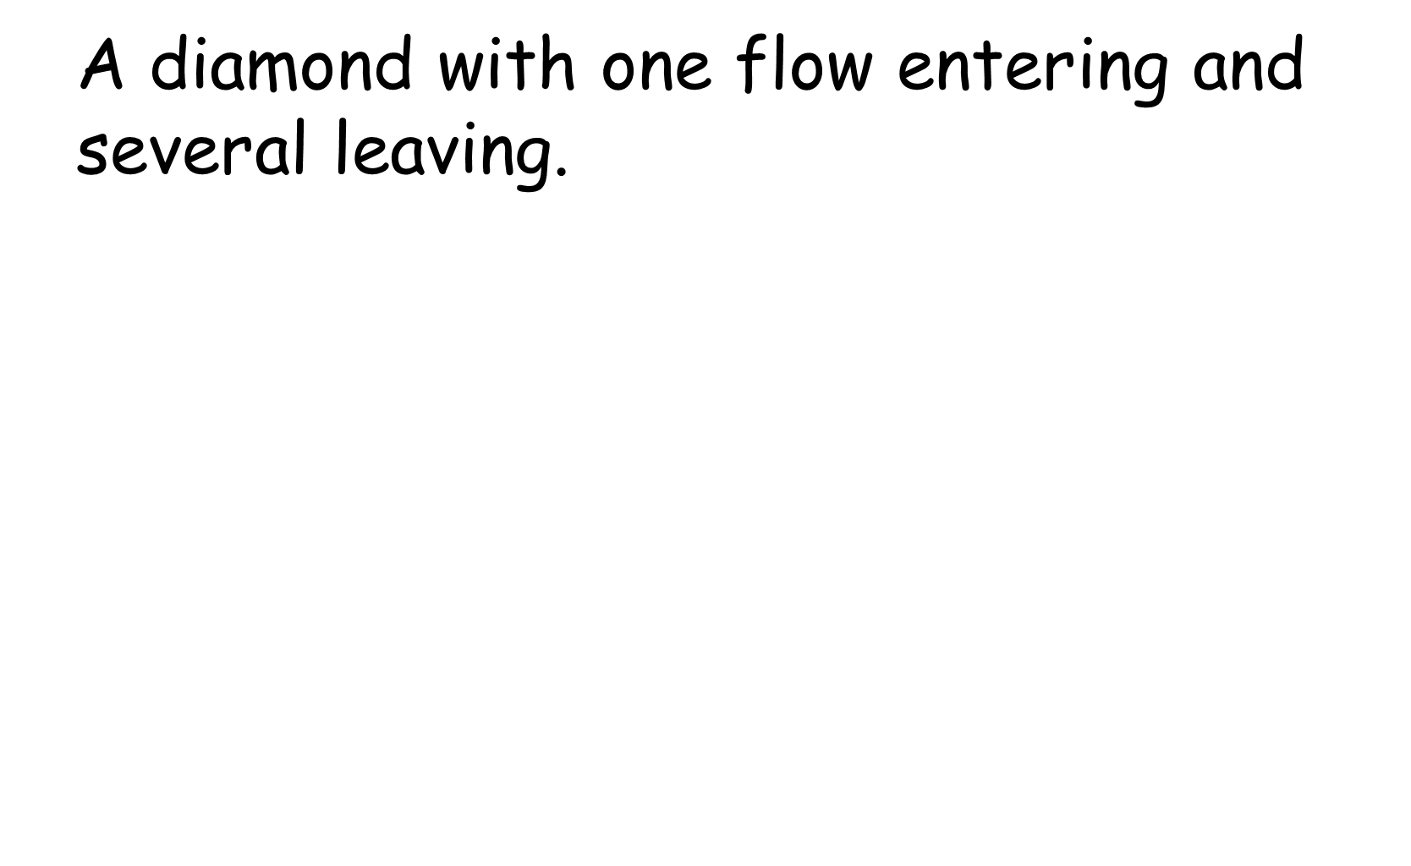
Decision
[Customer Is less than 21 Years Old]
Customer Orders Drink
[Customer Is At least 21 Years Old]
Get Drink For Customer

Slide 146
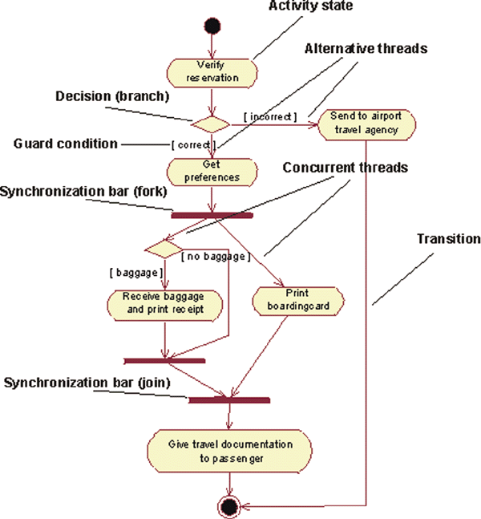
Check-In in the Business Use-Case Model of Airport Check-in

Slide 147
Activity Diagram Example: Student Admission
initial
Initialize
activity
Add student
fork/spawn
Notify Teacher
Notify Billing
Synchronization
[else]
[ count < 10 ]
guard
Close course
final

Slide 148
Activity Diagram vs Flow Chart
Can represent parallel activity and synchronization aspects
Swim lanes can be used:
  To group activities based on who is performing them
Example: Academic department vs. Hostel

Slide 149
Customer
Sales
Stockroom
Request service
Take Order
Pay
Fill Order
Deliver order
Collect order
C-S 546

Slide 150
Another Example Activity Diagram: student admission process
Academic Section
Accounts Section
Hostel Office
Hospital
Department
check
student
records
receive
fees
allot
hostel
create
hospital
record
receive
fees
register
in
course
conduct
medical
examination
allot
room
issue
identity card

Slide 151
Activity Diagram: Example 3
Finance
Order
Processing
Stock
Manager
Receive
Order
Receive
Supply
*[for each line
item on order]
Choose
Outstanding
Order Items
Check
Line Item
Authorize
Payment
[failed]
* [for each chosen
order item]
Cancel
Order
[in stock]
Assign to
Order
Assign
Goods to
Order
[succeeded]
[need to reorder]
Reorder
Item
[stock assigned to all
line items and payment
authorized]
[all outstanding
order items filled]
Dispatch
Order

Slide 152
Activity Diagram Example 4
Customer
Telesales
Accounting
Warehouse
Request
Return
Get Return
Number
Ship Item
Receive
Item
Item
[returned]
Restock
Item
Credit
Item
Account
[available]
Notes:
Diagram assumes that:
1) Receive Item and the OFS Item can be traversed in parallel. Same for Credit Account and Item OFS.
2) Restock item will not start until its Item input has arrived.
3) State machine can terminate with hanging Item OFS.
These are natural assumptions for an object flow language, but UML is state machine based.

Slide 153
Activity Diagram Exercise: Receive Order
When an order is received, each line item is checked on the order to see if goods is in stock.
  If in stock, assign the goods to the order.
  If this assignment reduces stock below reorder level,
    Reorder the goods.
While doing this, it is checked to see if the payment is OK.
  If the payment is OK and the goods in stock, dispatch the order.
  If the payment is OK but don’t have the goods, leave the order waiting.
  If the payment isn’t OK, cancel the order.

Slide 154
Activity Diagram for Receiving Order
Receive
order
* for each line
item on order
Check line
item
Authorise
Payment
[failed]
[in stock]
[succeeded]
Assign
to Order
Cancel
Order
[need to reorder]
Reorder
item
[stock assigned
to all line items
and payment
authorised]
Dispatch
Order

Slide 155
Activity Diagram Exercise: Receive Supply
When a supply delivery comes in:
  Outstanding orders are examined to decide which ones can be fulfilled from this incoming supply.
  Then assign each o to its appropriate order.
  Doing this may release those orders for dispatching.
Put the remaining goods into stock.

Slide 156
Activity Diagram for receiving Supply
Receive
Supply
Choose outstanding
order items
* for each chosen order item
Assign goods
to order
[all outstanding order items filled]
Add remainder
to stock
Dispatch
Order

Slide 157
Combined Activity Diagram
Receive
order
Receive
Supply
* for each line
item on order
Choose
outstanding
order items
Check line
item
Authorise
Payment
[failed]
[in stock]
* for each chosen order item
[succeeded]
Assign
to Order
Assign goods
to order
Cancel
Order
[need to reorder]
Reorder
item
[stock assigned
to all line items
and payment
authorised]
[all outstanding order items filled]
Dispatch
Order
Add remainder
to stock

Slide 158
Order
Processing
Finance
Stock
Manager
Receive
order
Receive
Supply
* for each line
item on order
Choose
outstanding
order items
Check line
item
Authorise
Payment
[failed]
[in stock]
* for each chosen order item
[succeeded]
Assign
to Order
Assign goods
to order
Cancel
Order
[need to reorder]
Reorder
item
[stock assigned
to all line items
and payment
authorised]
[all outstanding order items filled]
Dispatch
Order
Add remainder
to stock
With Swim lanes

Slide 159
Quiz 1: Order Processing
The customer service Department receives order and sends out invoice to the customer.
  It also passes on the order to the order processing Department to process the order
If it is a rush order then the customer service Department prepares for an overnight delivery by express mail
  Otherwise it prepares to send by speed post.
As soon as the payment is received by the finance Department from the customer:
  The order is dispatched by the customer service Department and it also closes the order.

Slide 160
Customer services department
Order Processing department
Receive order
Finance department
Fill order
Send invoice
[rush order]
[Else]
Overnight delivery
Ordinary delivery
Receive payment
Quiz 1:
Answer
Close order

Slide 161
State Chart Diagram

Slide 162
State Chart Diagram
Used to model how the state of an object changes in its life time
Good at describing how the behaviour of an object changes across several use case executions.

Slide 163
State Machine Diagram

Slide 164
Krishna air travels (KAT) allows its registered customers to book cars for travel to outstation locations or for drops at the local Railway station. Before any one can book a car, he/she is required to register once with KAT by providing name, residential address, phone number, and identity proof. KAT entertains registration requests from only the students and faculty members of IIT and rejects requests received from any other person. Once a request from a registered student or faculty is received by the KAT reception, the request is sent to the accounts department who prepare a duty slip (indicates driver name, Vehicle number, customer name and address, and the date, time, and other specifics of the travel) and hand it out to the driver. Whenever, outstation travel is involved, in addition to duty slip generation, the accounts Department also sends the vehicle to the maintenance department to make it journey worthy and to fill up diesel. After the journey is performed, the driver takes the signature of the customer on the duty slip and hands it over to the accounts department. The accounts department prepares the bill that the customer can download online. After the customer pays the bill online, the records of journey are archived by the accounts department.
Quiz 2

Slide 165
1. Develop use case diagram. No text description is necessary. [8]
2. Develop activity diagram for car booking, including customer registration process. [10]
3. Design preliminary class diagram [10]
4. Develop a sequence diagram to model object interactions for booking a car for station drop [10]

Slide 166
Stateless vs. Stateful Objects
State-independent (modeless):
  Type of objects that always respond the same way to an event.
State-dependent (modal):
  Type of objects that react differently to events depending on its state or mode.
  Use state machine diagrams for modeling state-dependent objects with complex behavior.

Slide 167
Basic State Machine Diagram
Graphical representation of automata behavior…
on
Lamp On
on
off
Lamp Off
off

Slide 168
State Chart Diagram Cont…
State chart avoids two problems of FSM:
  State explosion
  Lack of support for representing concurrency
A hierarchical state model:
  Can have composite states --- OR and AND states.

Slide 169
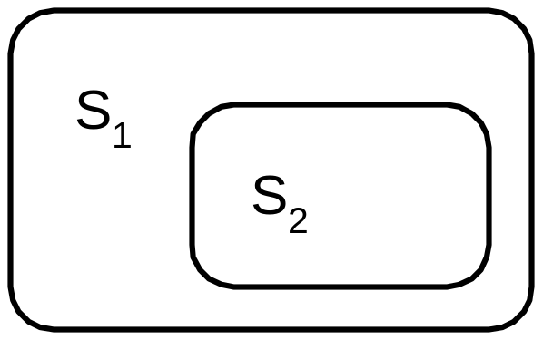
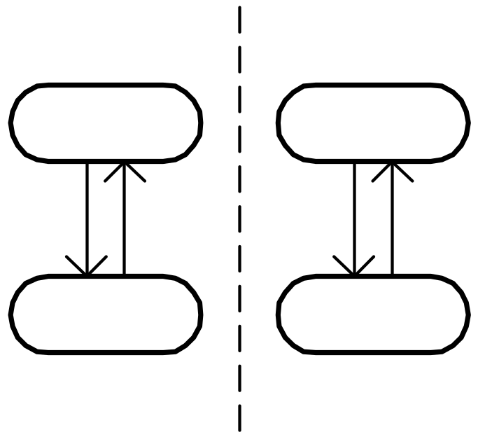
Features of Statecharts
Two major features are introduced :
  nested states
  concurrent states
Many other features have also been added:
  History state
  broadcast messages
  actions on state entry, exit
  …
Nested State Diagrams
Concurrent State Diagrams

Slide 170
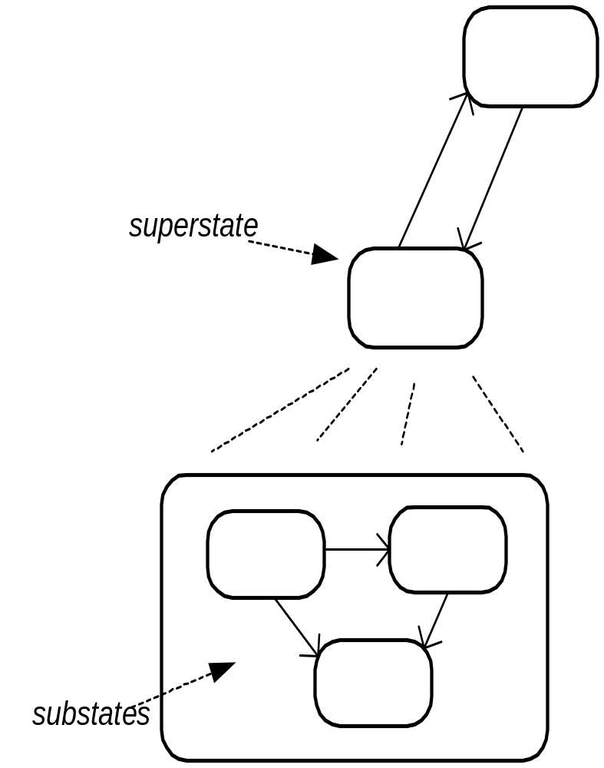
Nested State Diagrams
Hierarchical organization is a classic way to control complexity:
  of programs
  of documentation
  of objects
  …
Why not state diagrams?
  superstates
  substates

Slide 171
State Chart Diagram
Cont…
Elements of state chart diagram
Initial State: A filled circle
Final State: A filled circle inside a larger circle
State: Rectangle with rounded corners
Transitions: Arrow between states, also boolean logic condition (guard)‏

Slide 172
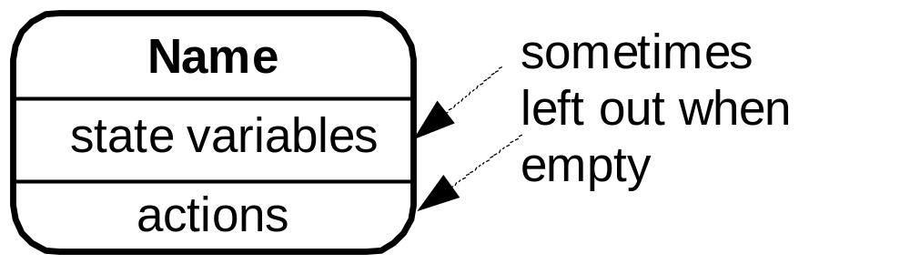
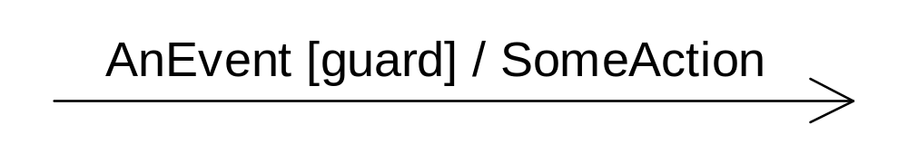
Basic UML State Diagram Syntax
A state is drawn with a round box, with three compartments for:
  name
  state variables
  actions performed
A transition is drawn with a labeled arrow,
  event causing the transaction
  guard condition
  Action to perform

Slide 173
Basic UML State chart Diagram
“top” state
State
Initial
pseudostate
top
Trigger
Ready
Transition
stop
/ctr := 0
Done
Final
state
Action
stop

Slide 174
Guards
Boolean predicates to indicate Conditional execution of transitions
bid [value < 100] /reject
Selling
bid [value >= 200] /sell
Happy
bid [(value >= 100) & (value < 200)] /sell
Unhappy

Slide 175
Example of A State Chart Diagram
order received
Unprocessed
Order
[reject] checked
[accept] checked
Rejected
Order
Accepted
Order
[some items available]
processed / deliver
[some items not
available] processed
Pending
Order
[all items
available]
newsupply
Fulfilled
Order
Example: State chart diagram for an order object

Slide 176
Developing Statecharts from use Cases
1. Collect the actions, conditions and results from a use case description.
2. Develop a preliminary statechart with those actions and conditions as the events, the results and the states.
3. Consider any alternative external events not in the use case.
4. Refine into hierarchical and concurrent statecharts.

Slide 177
Exercise
Draw the state chart diagram of an elevator.
The elevator is by default at the ground floor.
It moves up when an up button is pressed and halts when the required floor is reached.
When a button at a lower floor is pressed:
  It moves down and halts when the required floor is reached.
When it is inactive at a floor for more than 10 minutes:
  It moves down to the ground floor.

Slide 178
Elevator: State Machine Representation
On Ground
Floor
up floor
Moving
Up
arrive
at floor
Moving to
Ground Floor
arrive
at floor
up floor
Moving
Down
arrive at floor
Idle
down floor
time-out

Slide 179
Improvements in UML 2.0

Slide 180
Diagrams and views in UML
Behavioural View
Sequence Diagram
Collaboration Diagram
- State-chart Diagram
- Activity Diagram
Structural View
Class Diagram
Object Diagram
User’s View
Use Case
Diagram
Implementation View
Component Diagram
Environmental View
Deployment Diagram

Slide 181
Package Diagrams
A package is a grouping of several classes:
  Java packages are a good example
Package diagrams show module dependencies.
Useful for large projects with multiple binary files
Order Capture
UI
AWT
Mailing List
UI
Order Capture
Application
Mailing List
Application
Dependency
Common
{global}
Oracle
Interface
Quantity
Money
DateRange
Domain
Orders
Customers
Sybase
Interface
Database
Interface
{abstract}

Slide 182
Component Diagram
What is a component?
  A piece of software that can be independently purchased and upgraded, and can integrate seamlessly into customers’ existing software.
Librarian
Librarian
UML 1 notation
UML 2 notation

Slide 183
Component Diagram
Captures physical structure of the implementation in terms of various components of the system.
Purpose:
  Organize source code
    To be able to construct an executable release
  Specify dependencies
    Among different components

Slide 184
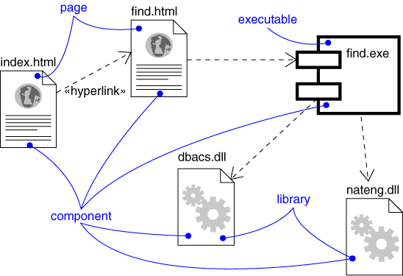
Component Diagram
Captures the physical structure of the implementation (code components)‏
UML 1.X Notation
dependency
Components:
Executables
Library
Table
File
Document

Slide 185
Ball and Socket notation for Interfaces
Ball and socket notation is new in UML 2.0.
Components that consume (require) an interface:
  Display a "socket" labeled with the interface name .
Components that provide (implement) an interface:
  Display a "ball" labeled with the interface name.
Combining the two:
  A compact way to say that Consumer talks to the provider via the named interface.

Slide 186
Component Diagram: Example
Library
UI
Librarian
DB
Ports can be named, such as the Security and Data ports
Database
A package diagram can be used to provide a high-level view of each component in terms of different classes it contains

Slide 187
Diagrams and views in UML
Behavioural View
Sequence Diagram
Collaboration Diagram
- State-chart Diagram
- Activity Diagram
Structural View
Class Diagram
Object Diagram
User’s View
Use Case
Diagram
Implementation View
Component Diagram
Environmental View
Deployment Diagram

Slide 188
Deployment Diagram
The deployment diagram shows:
  How a software system will be physically deployed in the hardware environment.
Its main purpose is:
  Show which component will execute on which hardware component and
  How they will communicate with each other.
Since the diagram models the runtime architecture of an appln.
  Diagram can be very useful to system's operation staff

Slide 189
Deployment Diagram
Node:
  Something that can host an artifact.
  A node represents a physical machine.
  To model a node, draw a three-dimensional cube with the name of the node at the top.
  Physical nodes should be labeled with the stereotype device
Artifact:
  Files, assemblies, DLL, or scripts
  An artifact is usually a component

Slide 190
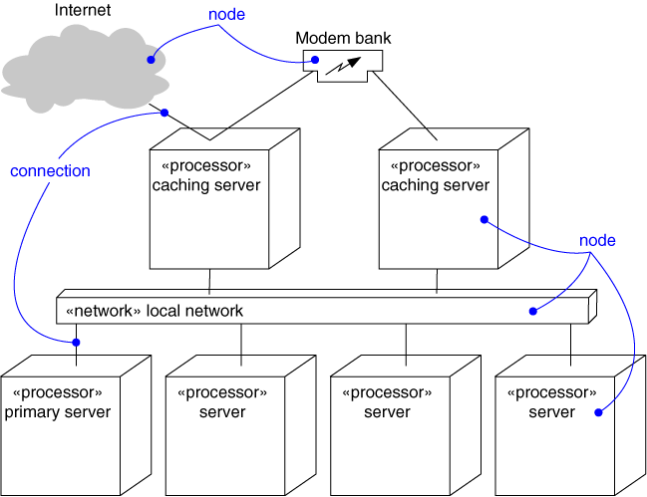
Deployment Diagram
Captures the topology of a system’s hardware
A piece of hardware

Slide 191
Architectural Modeling Using
Deployment Diagram
Terminal
2
Terminal
Terminal
X
1
Branch
Server
ATM X
Terminal
1
Branch
Hub
Central
Terminal
Server
Bank
2
ATM 1
ATM 2
Terminal
X

Slide 192
New Notations in UML 2
UML 2 was a major revision of the UML standard.
Several new notions and concepts have been introduced.
  Based on feed back from practitioners
  Can now be applied meaningfully to many classes of problems such as embedded and telecommunication software development.

Slide 193
UML 2 Diagrams
UML now defines thirteen types of diagrams, divided into three categories:
  Six diagrams represent static application structure
  Three represent different aspects of dynamic behavior
  Four represent Interaction among your application modules

Slide 194
UML Structural Diagrams
Class Diagram
Object Diagram
Component Diagram
Composite Structure Diagram
Package Diagram
Deployment Diagram
Notes:
If you choose to use plain text on a slide without photos or graphs, choose this layout.
Subtitles should be 28 pt Arial.

Slide 195
UML Behavior diagrams
Use Case Diagram
Activity Diagram
State machine Diagram
Notes:
If you choose to use plain text on a slide without photos or graphs, choose this layout.
Subtitles should be 28 pt Arial.

Slide 196
UML Model Interaction Diagrams
Sequence Diagram
Communication Diagram
Timing diagram
Interaction Overview Diagram
Notes:
If you choose to use plain text on a slide without photos or graphs, choose this layout.
Subtitles should be 28 pt Arial.

Slide 197
UML 2.0 Highlight of Changes list is not comprehensive
Introduced new concept of Ports
Composite Structure Classes & Diagrams
Class Diagrams – the least changed
Collaboration Diagram – renamed to
Communication Diagram
Sequence Diagram – nesting options
New diagram introduced – Timing Diagram
Notes:
If you choose to use plain text on a slide without photos or graphs, choose this layout.
Subtitles should be 28 pt Arial.

Slide 198
UML 2.0 Highlight of Changes list is not comprehensive
Activity Diagrams have the greatest number of changes of any of the UML diagrams
Use Case Diagrams – added multiplicity and changes with extension points.
Package Diagram now an official UML diagram.
Notes:
If you choose to use plain text on a slide without photos or graphs, choose this layout.
Subtitles should be 28 pt Arial.

Slide 199
Combined Fragments in sequence diagrams
Composite Structure Diagram
Notes:
If you choose to use plain text on a slide without photos or graphs, choose this layout.
Subtitles should be 28 pt Arial.

Slide 200
Combined Fragments in sequence diagrams
Anatomy:
Appears over an area of a sequence diagram to make certain control and logic aspects visually clear .
Divides a sequence diagram into a number of areas or fragments that have different behaviour
Consists of many fragments and an operator shown at the top left corner .
Each fragment can be associated with a guard (a Boolean expression).
Notes:
If you choose to use plain text on a slide without photos or graphs, choose this layout.
Subtitles should be 28 pt Arial.

Slide 201
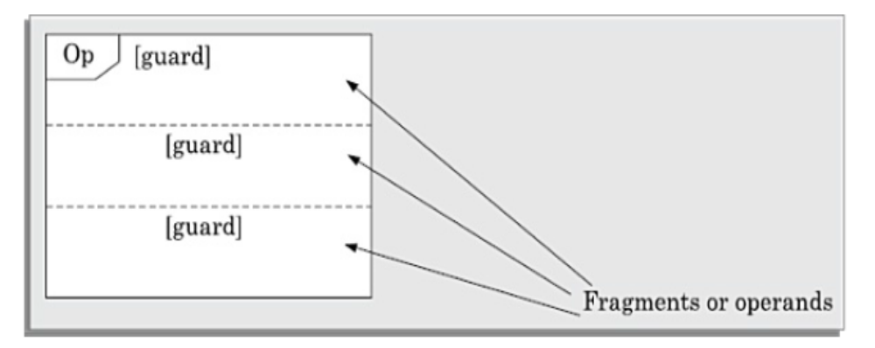
Combined Fragments in sequence diagrams..
Anatomy of a combined fragment
Notes:
If you choose to use plain text on a slide without photos or graphs, choose this layout.
Subtitles should be 28 pt Arial.

Slide 202
Combined Fragments in sequence diagrams..
Fragment:
Represented by a box, and encloses a portion of the interactions within a sequence diagram.
Each fragment is also known as an interaction operand.
An interaction operand may contain an optional guard condition, which is also called an interaction constraint.
The behaviour specified in an interaction operand is executed only if its guard condition evaluates to true.
Notes:
If you choose to use plain text on a slide without photos or graphs, choose this layout.
Subtitles should be 28 pt Arial.

Slide 203
Combined Fragments in sequence diagrams..
A combined fragment is associated with one operator called interaction operator that is shown at the top left corner of the fragment.
The operator indicates the type of fragment. The type of logic operator along with the guards in the fragment defines the behaviour of the combined fragment.
A combined fragment can also contain nested combined fragments that represent more complex structures that affect the flow of messages.
Notes:
If you choose to use plain text on a slide without photos or graphs, choose this layout.
Subtitles should be 28 pt Arial.

Slide 204
Combined Fragments in sequence diagrams..
Some imp. operators
    loop – repeat interaction fragment
    alt – selection
    par – concurrent (parallel) regions
    opt – optional “exemplar”
    Region - critical region – only one thread can execute
Notes:
If you choose to use plain text on a slide without photos or graphs, choose this layout.
Subtitles should be 28 pt Arial.

Slide 205
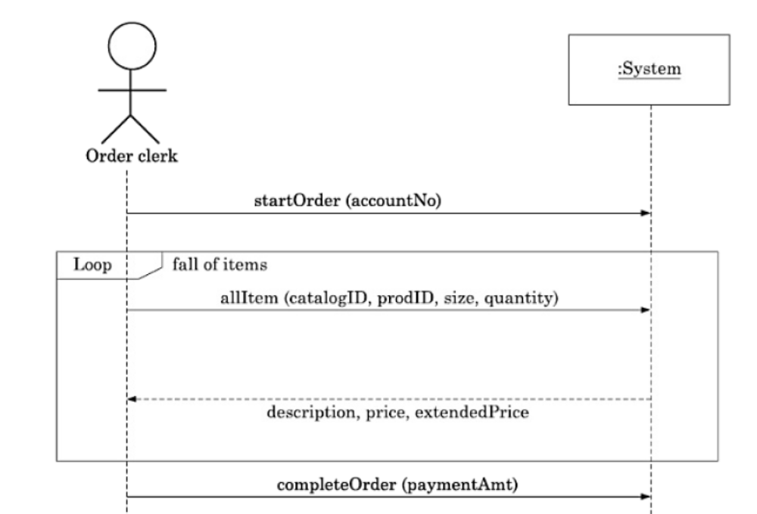
Combined Fragments in sequence diagrams..
An example sequence diagram showing a combined fragment

Slide 206
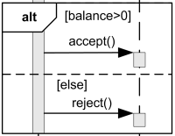
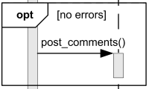
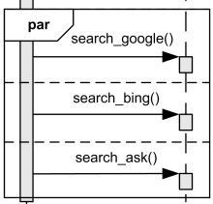
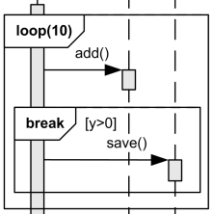
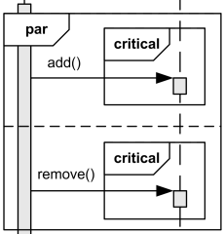
Combined Fragments in sequence diagrams..

Slide 207
Ports
A Port is a named interface on a component:
  It defines a set of operations and events that are provided by a component or that are required from its environment.
The port has:
  A name.
  An interface specifying the signals that can be received.
  An interface specifying the signals that can be sent.
Two types of ports:
  Connected to internal communication channels (by default).
  Connected to the state machine for the class instance (a behaviour port).
In interface
Out interface
A behaviour port

Slide 208
Combined Fragments in sequence diagrams
Composite Structure Diagram
Notes:
If you choose to use plain text on a slide without photos or graphs, choose this layout.
Subtitles should be 28 pt Arial.

Slide 209
Composite Structure Diagram
The composite structure diagram lets you define how a class is defined by
  a further structure of classes and
  the communication paths between these parts.

Slide 210
Composite Structure Diagram
Some new core constructs such as parts, ports and connectors:.
Part: The concept of parts makes possible the description of the internal structure of a class.
Port: The concept of a port makes it possible to describe connection points formally. These are addressable, which means that signals can be sent to them.
Connector: Connectors can be used to specify the communication links between two or more parts.

Slide 211
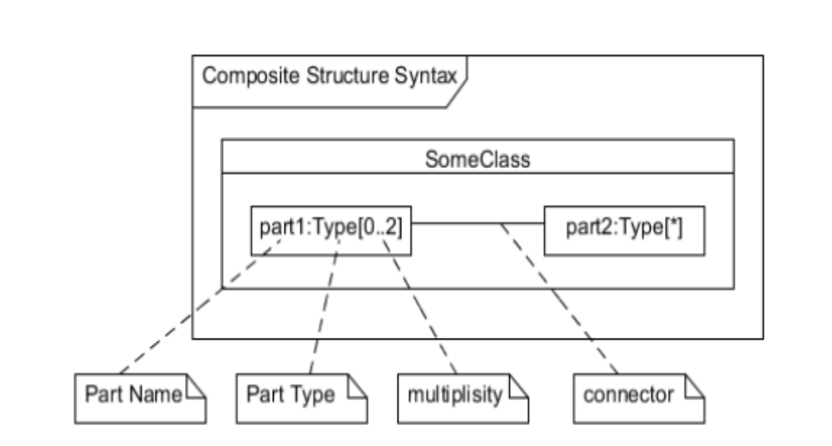
Syntax of Composite Structure Diagram

Slide 212
Composite Structure Diagram
A composite structure diagram:
  Shows the relationship among internal components of a class, in terms of communication paths.
Class may have one or more communication ports
  through which signals can be sent or received.
The ports are connected either to:
  Internal components
    Channels connect the ports of the class to the ports of the internal components.
    Channels can be unidirectional (one direction only) or bidirectional (both directions).
  The state machine behaviour of the class (a behaviour port).

Slide 213
Object instance reference
instance name
OutPort
Switch2 : Switch
class name
InPort

Slide 214
Object instance reference
instance name
OutPort
Switch2 : Switch
class name
InPort

Slide 215
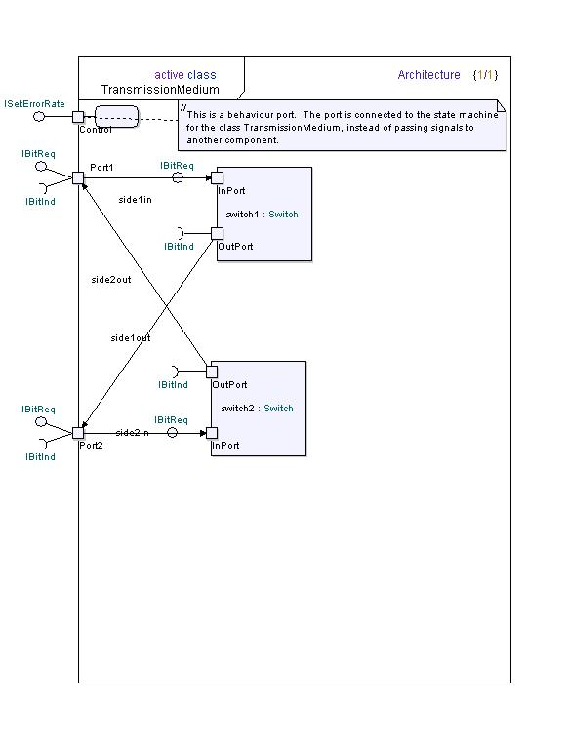
Composite Structure

Slide 216
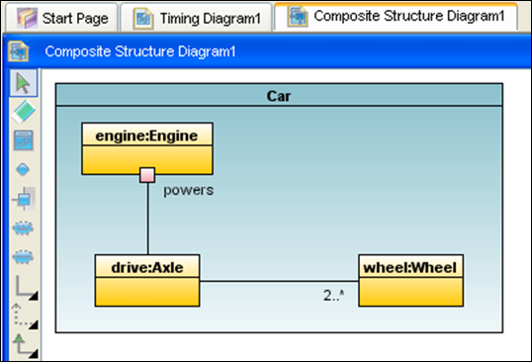
Composite Structure Diagram
Lets you capture how a class is defined by a further structure of classes
  and the communication paths between these parts.

Slide 217
Tools Supporting UML 2.0
PlantUML
Open Source ArgoUML
ARTiSAN's Real-time Studio
Borland Together 2006 for Eclipse
Computas' Metis with UML 2.0 Template
Embarcadero Describe
IBM Rational Software Architect and Modeler
I-Logix Rhapsody
MetaMatrix MetaBase Modeler
Mia Software Model-in-Action
No Magic's MagicDraw UML

Slide 218
Tools Supporting UML 2.0 continued……..
OMONDO EclipseUML Studio
Pathfinder Solutions' PathMATE 5.2
Open Source StarUML sponsored by Plastic Software
Sparx Systems Enterprise Architect
Sun Microsystems' Java Studio Enterprise
Pattern Weaver Ver. 2.0 Technologic Arts Inc. (Japanese)
Telelogic's TAU Developer and TAU Architect
Gentleware's Poseidon for UML
Visual Paradigm's Smart Development Environment tool series

Slide 219
Review Questions
Choose the correct option:
The packing of data and functions into a single unit in a program is known as:
polymorphism
abstraction
encapsulation
inheritance

Slide 220
Review Questions
Consider the statement—“An employee is either a worker or a manager .” Assuming that Employee and Manager to be two classes, what can be said about the relationship between these two classes?
(i) Association
(ii) Generalisation-specialisation
(iii) Containment
(iv) Polymorphism

Slide 221
Review Questions
Which one of the following can be said about an abstract data type (ADT):
(i) Same as an abstract class
(ii) A data type that cannot be instantiated (iii) A data type that can only be used through the operations defined on it
(iv) Same as a collection of data items

Slide 222
Review Questions
Consider the sentence: A book has one or more pages. Which of the following concepts characterise it best ?
(i) Inheritance
ii) Specialisation
(iii) Association
(iv) Composition

Slide 223
Review Questions
A sequence diagram is:
(i) A time-line illustrating a typical sequence of calls between object function members
(ii) A call tree illustrating all possible sequences of calls between class function members
(iii) A time-line illustrating the changes in inheritance and instantiation relationships between classes and objects over time
(iv) A tree illustrating inheritance and relationships between classes

Slide 224
Review Questions
State TRUE o r FALSE of the following. Support your answer with proper reasoning:
(a) An object oriented design cannot be implemented using a procedural programming language.
(b) Any language directly supporting abstract data types (ADTs) can be called as an object-oriented language.
(f ) Inheritance feature of the object oriented paradigm helps in code reuse.

Slide 225
Review Questions
State TRUE o r FALSE of the following. Support your answer with proper reasoning:
(g) Inheritance relationship between two classes can be considered as a generalisation- specialisation relationship.
(h) Object embedding (i.e., composite objects) can be used to realise inheritance relationship.
(i) Aggregation relationship between classes is antisymmetric.
(j) The aggregation relationship can be recursively defined, i.e an object can contain instances of itself.

Slide 226
Review Questions
State TRUE o r FALSE of the following. Support your answer with proper reasoning:
(k) State chart diagrams in UML are normally used to model how some behaviour of a system is realised through the co-operative actions of several objects.
(l) Multiple inheritance is the feature by which many subclasses can inherit features of one base class.
(m) Class diagrams developed using UML can serve as the functional specification of a system.
(n) An important advantage of polymorphism is facilitation of reuse.

Slide 227
Review Questions
State TRUE o r FALSE of the following. Support your answer with proper reasoning:
(o) A static object-oriented model should capture attributes and methods of classes and in what order the different methods invoke each other.
(p) In a UML class diagram, the aggregation relationship defines an equivalence relationship on objects.
(r) The aggregation relationship can be considered to be a special type of association relationship.

Slide 228
Review Questions
State TRUE o r FALSE of the following. Support your answer with proper reasoning:
(u) Normally, you use one interaction diagram per class to represent how the behaviour of an object of the class changes over its life time.
(v) It is possible that more than one methods in a class implement the same operation.
(y) From the UML sequence diagram for a use case, it would be possible to infer the various scenarios in the use case.

Slide 229
Word of Caution!
Tools can be easily learned and used.
Too much focus on UML case tools does not make you any more a good designer:
  Than becoming an expert Word user makes you a famous writer of thriller stories.

Slide 230
End

